Slide 1
UNIT II

Slide 2
Simple (Unsmoothed) N-gram in NLP
N-grams are continuous sequences of words or symbols or tokens in a document and are defined as the neighboring sequences of items in a document. They are used most importantly in tasks dealing with text data in NLP (Natural Language Processing).
N-gram models are widely used in statistical natural language processing, speech recognition, phonemes and sequences of phonemes, machine translation and predictive text input, and many others for which the modeling inputs are n-gram distributions.

Slide 3
What are n-grams?
N-grams are defined as the contiguous sequence of n items that can be extracted from a given sample of text or speech. The items can be letters, words, or base pairs, according to the application. The N-grams typically are collected from a text or speech corpus (Usually a corpus of long text dataset).
N-grams can also be seen as a set of co-occurring words within a given window computed by basically moving the window some k words forward (k can be from 1 or more than 1).
The co-occurring words are called "n-grams," and "n" is a number saying how long a string of words we have considered in the construction of n-grams.
Unigrams are single words, bigrams are two words, trigrams are three words, 4-grams are four words, 5-grams are five words, etc.

Slide 4
Applications of N-grams: N-grams of texts are extensively used in the n-gram model in NLP, text mining, and natural language processing tasks.
Importance of order of words in text & NLP
In general, the order of the words that are used in the natural language of the text is not random. If we consider the English language, we can use the words "the green apple" but not "apple green the" in a sentence.
The relationships between words in the flow of the text are also very complex. N-grams are tooted as a relatively simple way of capturing some of these relationships between the words.
We can capture quite a bit of information by just looking at which words tend to show up next to each other more often. By constructing the n-grams, we can construct the co-occurring words and use them in modeling relationships and other applications.

Slide 5
How are n-grams Classified?
N-grams are classified into different types depending on the value that n takes. When 1n=1, it is said to be a unigram. When 2n=2, it is said to be a bigram. When 3n=3, it is said to be a trigram. When 4n=4, it is said to be a 4-gram, and so on.
Different types of n-grams are suitable for different types of applications in the n-gram model in nlp, and we need to try different n-grams on the dataset to confidently conclude which one works the best among all for the text corpus analysis.
It is also established with research and substantiated that trigrams and 4 grams work the best in the case of spam filtering.

Slide 6
An Example of n-grams
Let us look at the example sentence Cowards die many times before their deaths; the valiant never taste of death but once and generate the associated n-grams related to the sentence.
Unigrams: These are simply the unique words in the sentence.
  Cowards, die, many, times, before, their, deaths, the valiant, the valiant, never, taste, of, death, but, once.
Bigrams: These are simply the pairs of co-occurring words in the sentence formed by sliding one word at a time in the forward direction to generate the next bigram.
  cowards die, die many, many times, times before, before their, their deaths, deaths the, the valiant, valiant never, never taste, the taste of, of death, death but, but once
Trigrams: These are the 3 pairs of co-occurring words in the sentence formed by sliding two words at a time in the forward direction to generate the next trigram.
  cowards die many, die many times, many times before, times before their, before their deaths, their deaths the, deaths the valiant, the valiant never, valiant never taste, never taste of, taste of death, of death but, death but once
4-grams: Here we have the window such that we have combinations of 4 words together
  cowards die many times, die many times before, many, times before their, times before their deaths, before their deaths the, their deaths the valiant, deaths the valiant never, the valiant taste, valiant never taste of, never taste of death, taste of death but, of death but once
Simialary we can pick 5>4n>4 and generate 5-grams etc.

Slide 7
Backoff in NLP
Backoff and smoothing are techniques in NLP to adjust probabilities to tackle data sparseness and parameter estimation while building NLP models. The methods involve broadening the estimated probability distribution by redistributing weight from high-probability regions to zero-probability regions in a suitable fashion.
Language models
One of the underlying ideas behind language models is the simple idea that some word sequences are more frequent than others, which led to the development of language models for text and also gave rise to mainstream NLP research.
Issues with probability estimation in LM
When dealing with probability distributions to be estimated for language models, we come across scenarios related to determining the probability or likelihood estimate of a sequence of words (like a sentence) occurring together when one or more words individually (unigram) or N-grams such as bigram.

Slide 8
Even if one n-gram is unseen in the sentence, the probability of the whole sentence becomes zero.
Hence the probability of a test document given some class can be zero even if a single word in that document is unseen
One way to avoid this is to allot some probability mass by reserving for the unseen words.
Smoothing techniques are touted as solutions to tackle this major problem in building language models.
Example of unseen word Maximum Likelyhood Estimation using MLE: If we take the example of probability estimation using MLE, for the P(the | burnish). If the bigram "burnish the" doesn't appear in our training corpus, then P(the| burnish) = 0.
  But we know that no word sequence should have 0 probability as that can’t be intuitively right.
  Furthermore, MLE also produces poor estimates when the counts are non-zero but still small.
  Hence the need for better estimators than MLE for rare events, which is solved by somewhat decreasing the probability of previously seen events so that there is a little bit of probability mass left over for previously unseen events.

Slide 9
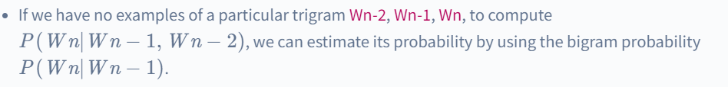
What is Backoff?
The general idea of backoff is that it always helps to use lesser context to generalize for contexts that the model doesn’t know enough about.
For example,we can use trigram probabilities if there is sufficient evidence, else we can use bigram or unigram probabilities.
It is the concept where sentences are generated in small steps which can be recombined in other ways.
If we have no examples of a particular trigram Wn-2, Wn-1, Wn, to compute

Slide 10
Issues of Sparsity in NLP
Language models use huge amounts of parameters on data to build the NLP models, and sparsity becomes an issue, and incorporating proper smoothing techniques into the models usually leads to more accuracy than the original models.
Data sparsity is another issue with language models, statistical modeling, and also NLP techniques in general, and smoothing can help with the performance issue.
Sometimes, we come across the extreme case where there is so much training data, and even though all parameters can be accurately trained without smoothing, even in such cases, it is almost always usual to expand the model such as by moving to a higher n-gram model to achieve improved performance and smoothing can help with such cases too.

Slide 11
Issues with Model Generalization in NLP
Language models, in general, use a huge amount of data for training, and the output of these models is dependent on the N-grams appearing in the training corpus. The models work well only if the training corpus is similar to the testing dataset; this is the risk of overfitting to the training set.
As with any machine learning method, we would like results that are generalizable to new information.
One of the other harder problems with language models and, in general, NLP is how we deal with words that do not even appear in training but are in the test data.
Thus, no matter how much data one has or how many parameters are there in the model, smoothing can almost always help performance for a relatively small effort.

Slide 12
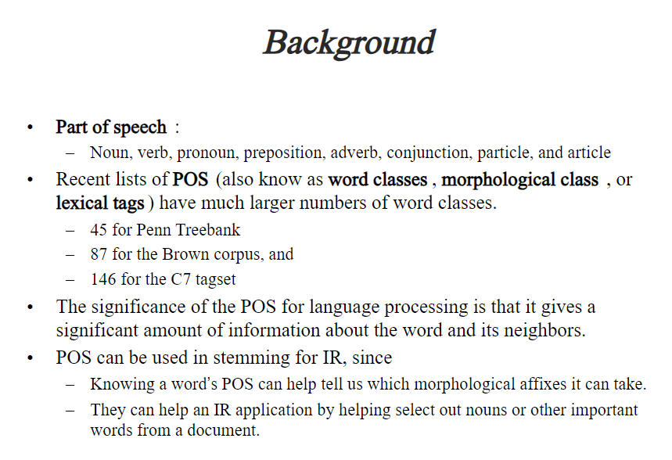
Part of Speech

Slide 13
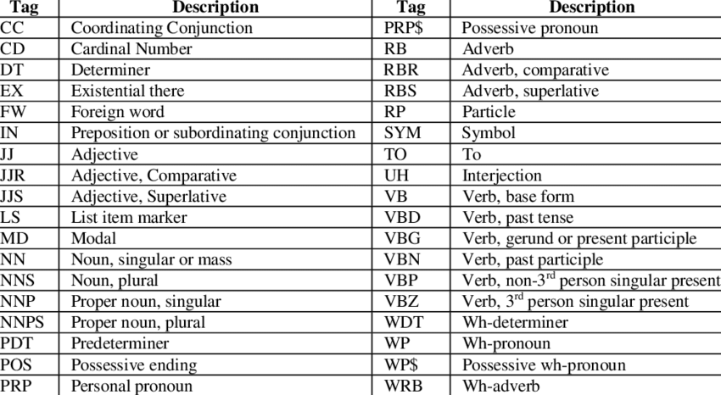
Penn Treebank PoS Tagging

Slide 14
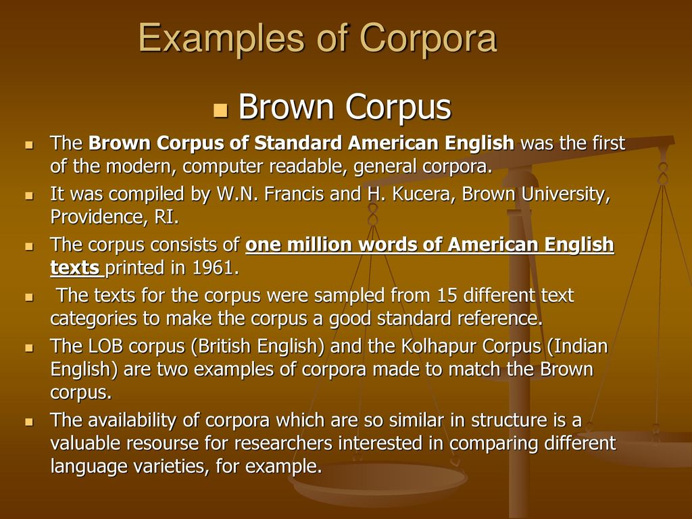

Slide 15
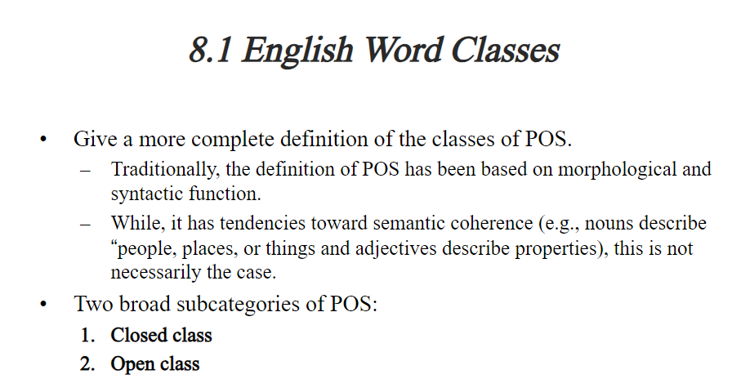

Slide 16
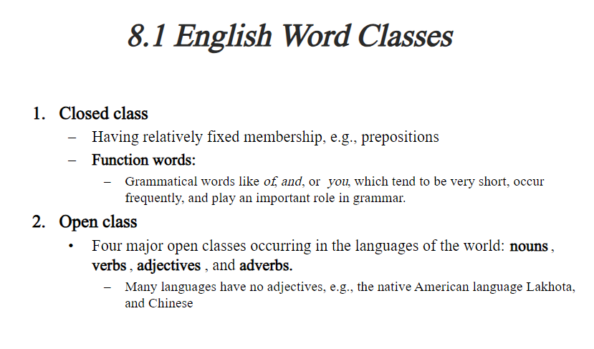

Slide 17
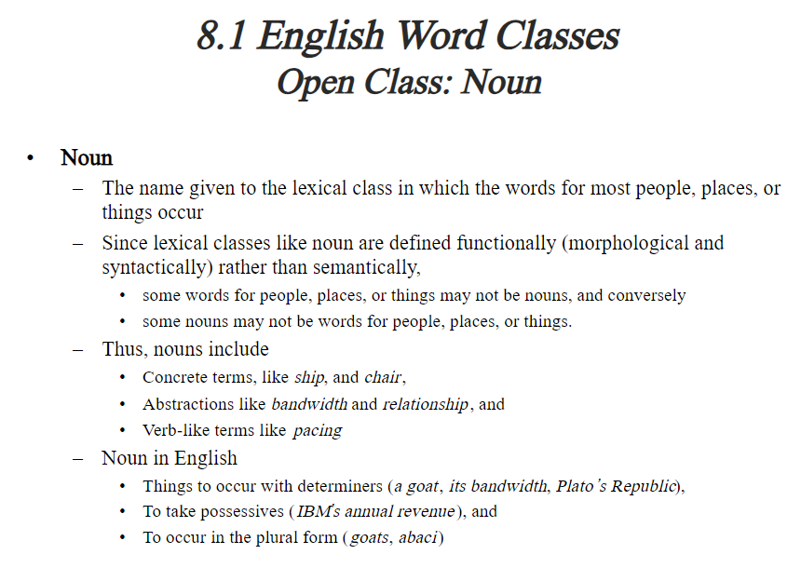

Slide 18
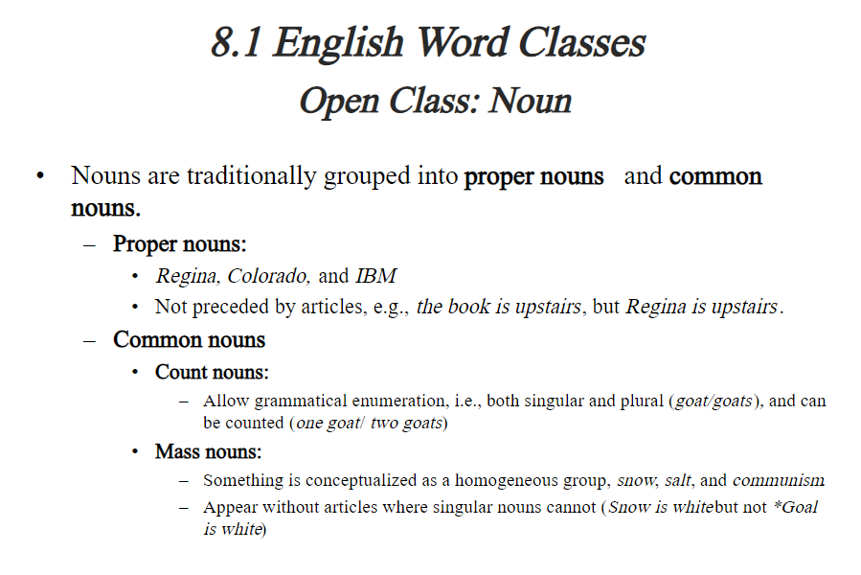

Slide 19
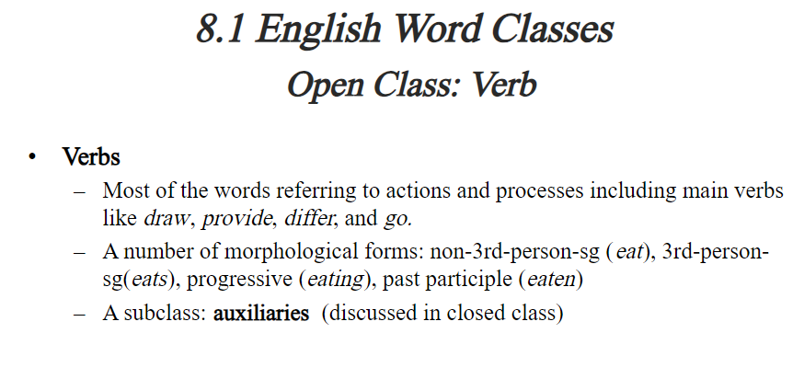

Slide 20
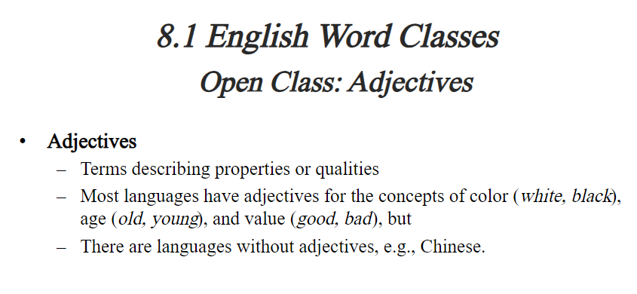

Slide 21
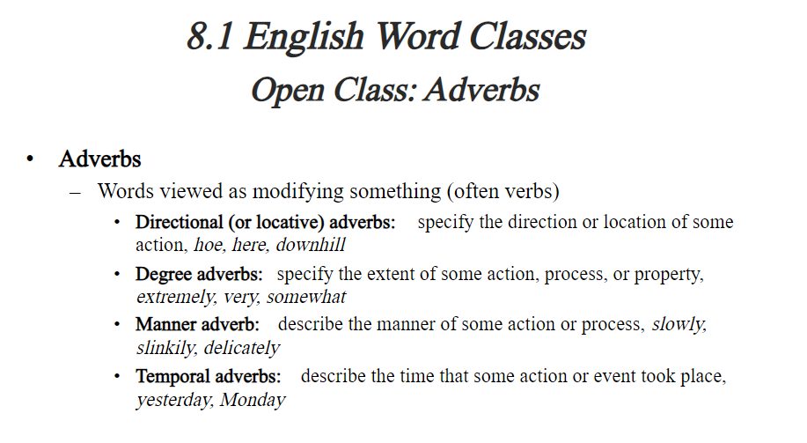

Slide 22
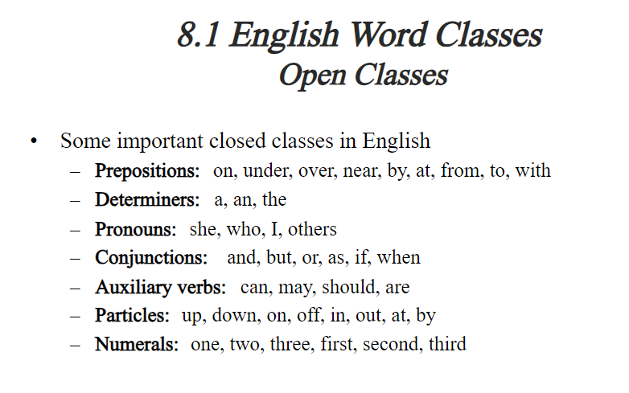

Slide 23
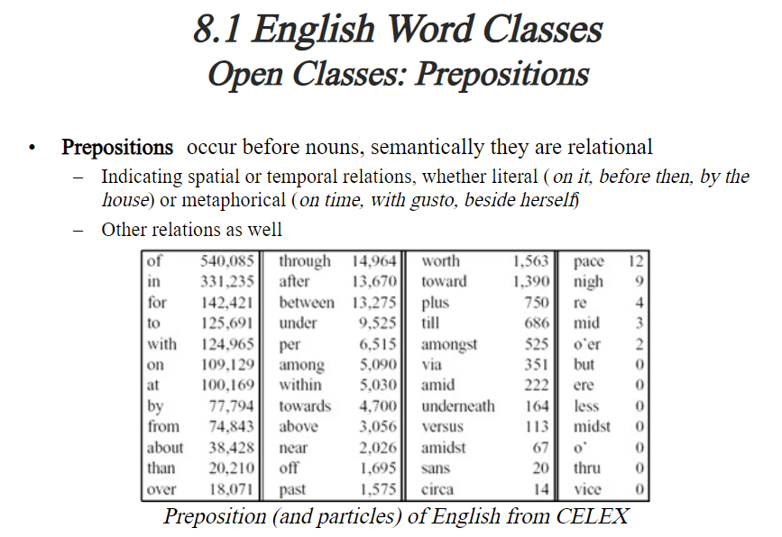

Slide 24
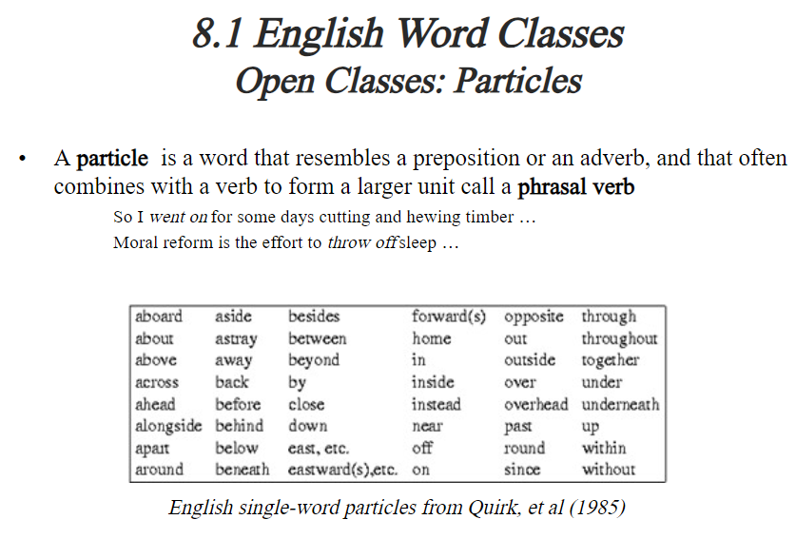

Slide 25
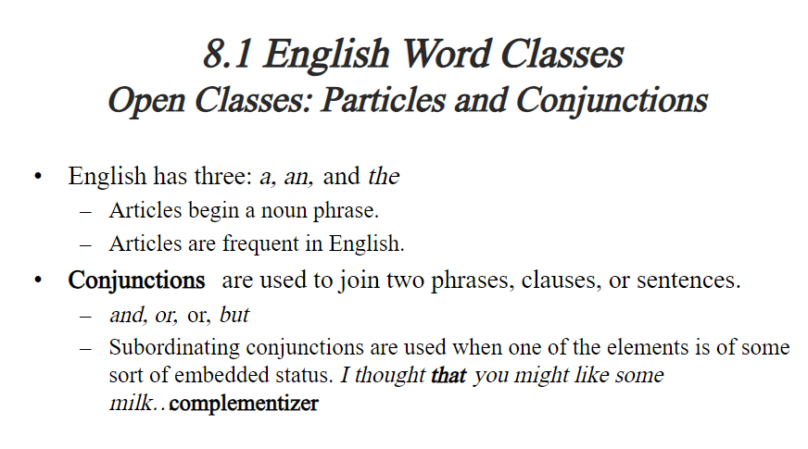

Slide 26
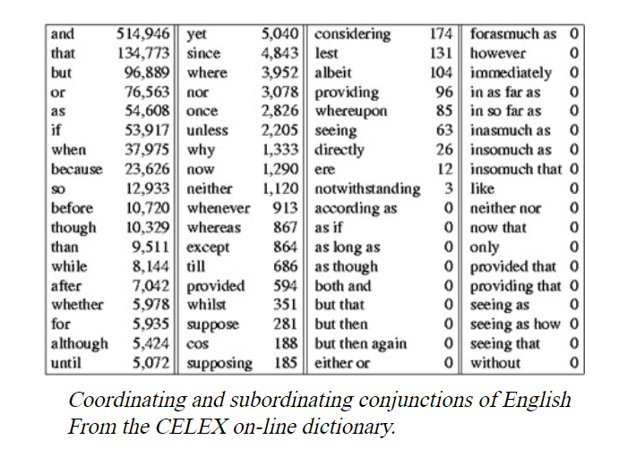

Slide 27
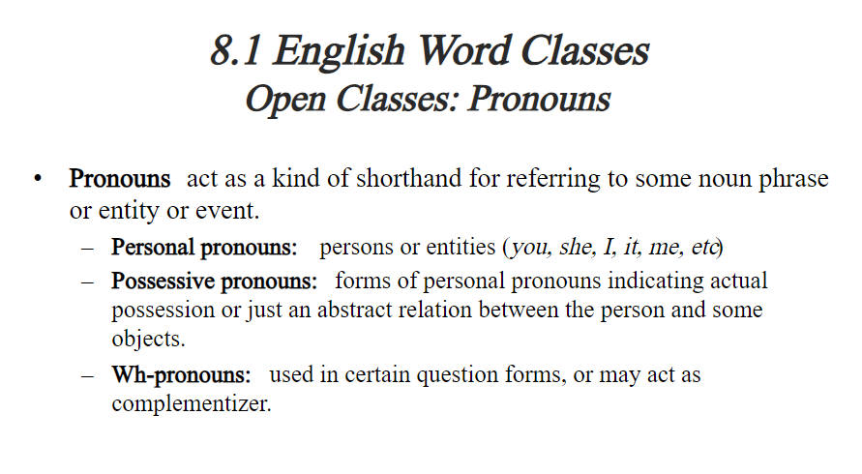

Slide 28
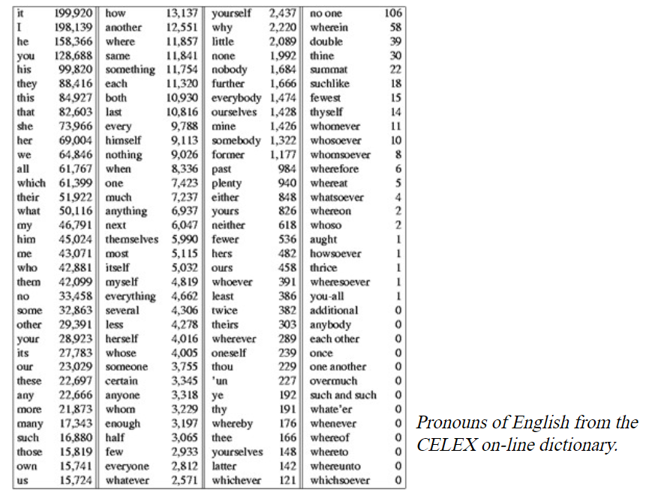

Slide 29
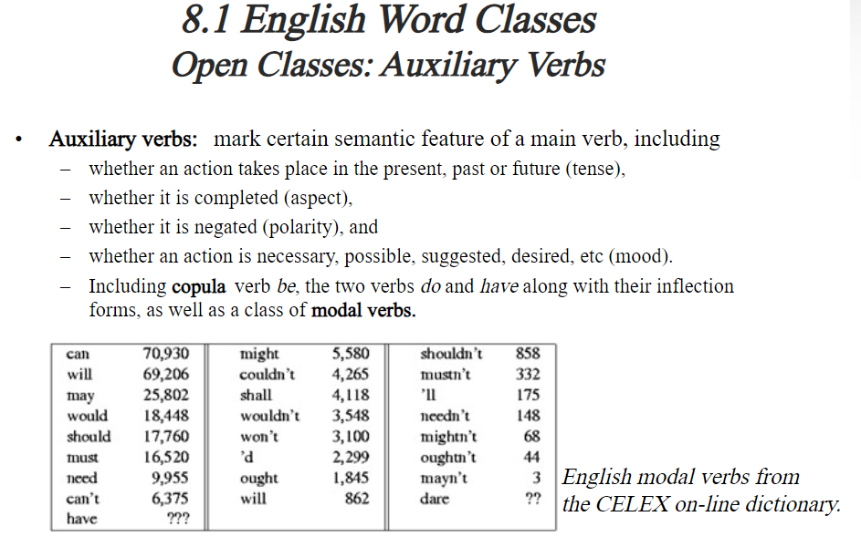

Slide 30
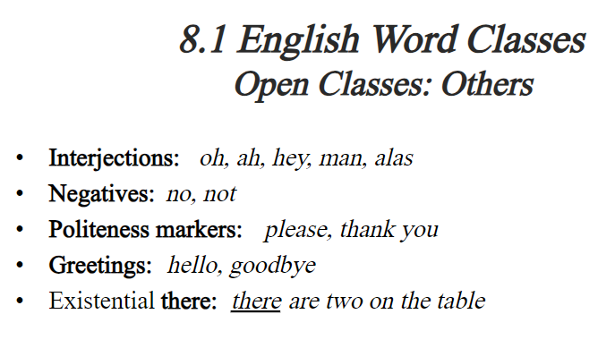

Slide 31
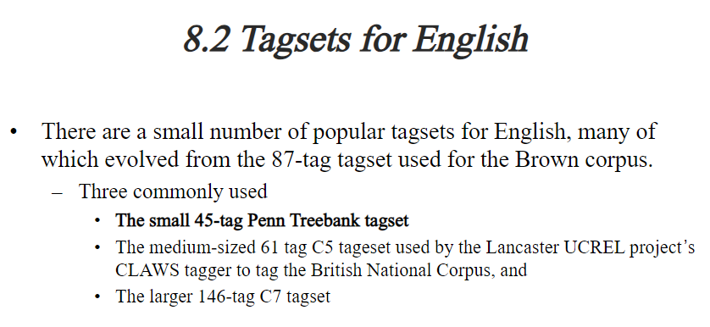

Slide 32
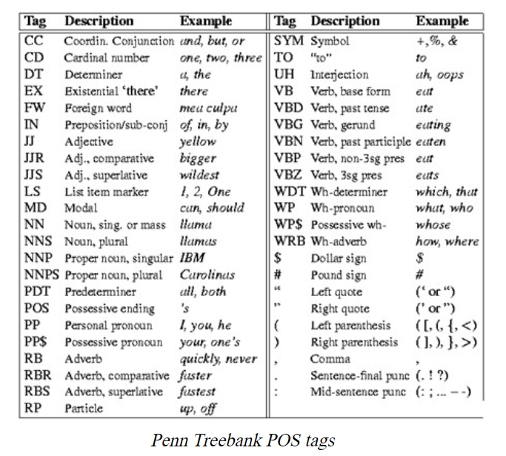

Slide 33
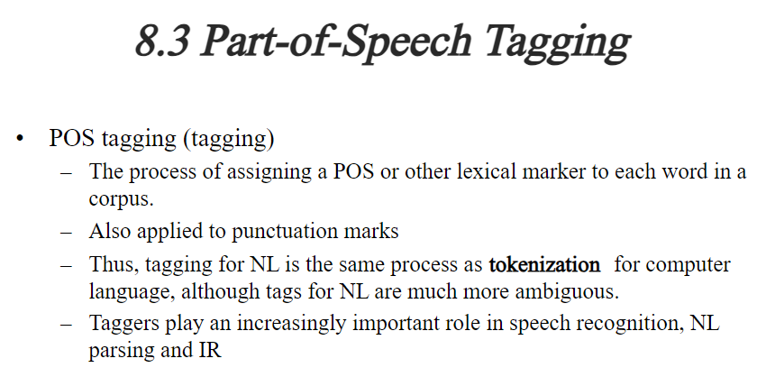

Slide 34
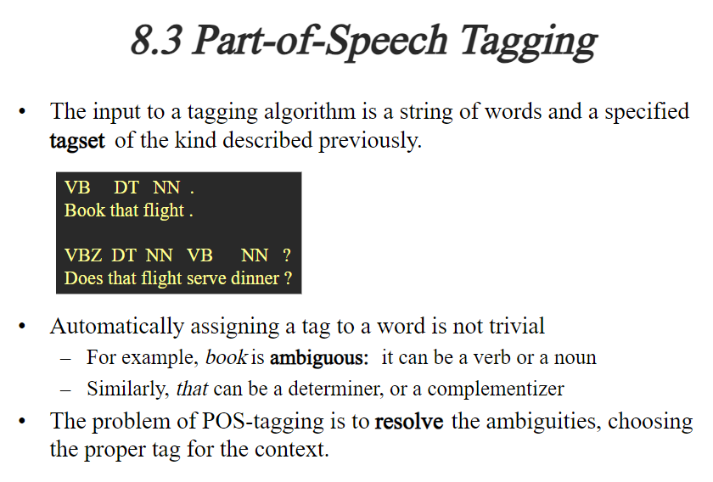

Slide 35
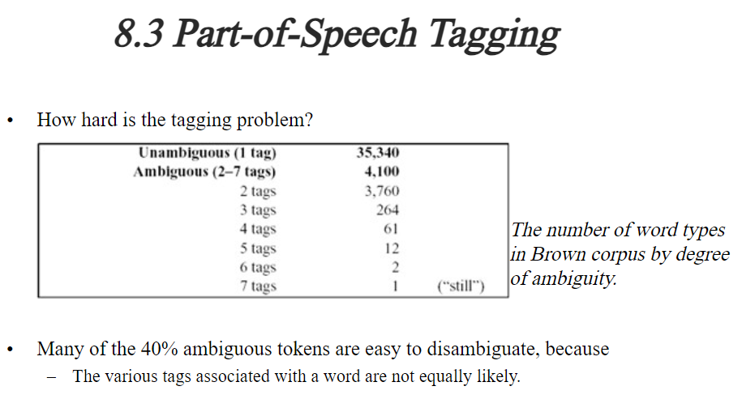

Slide 36
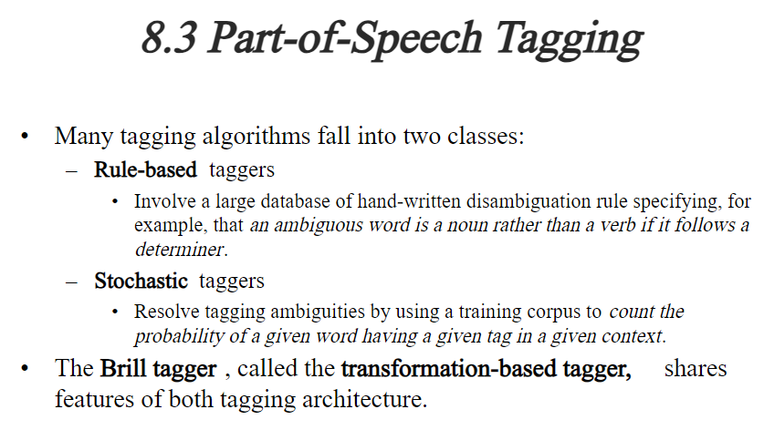

Slide 37
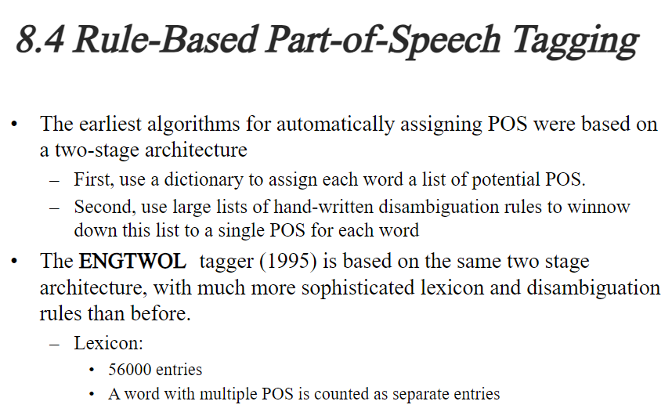

Slide 38
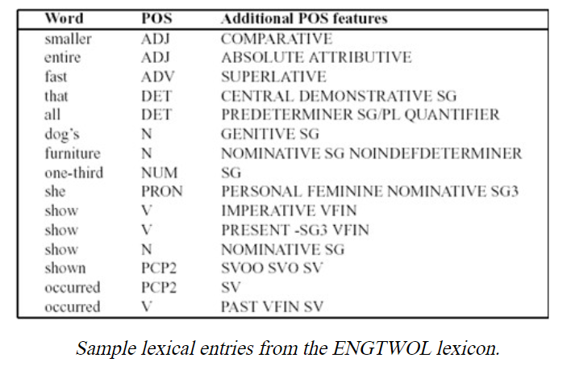

Slide 39
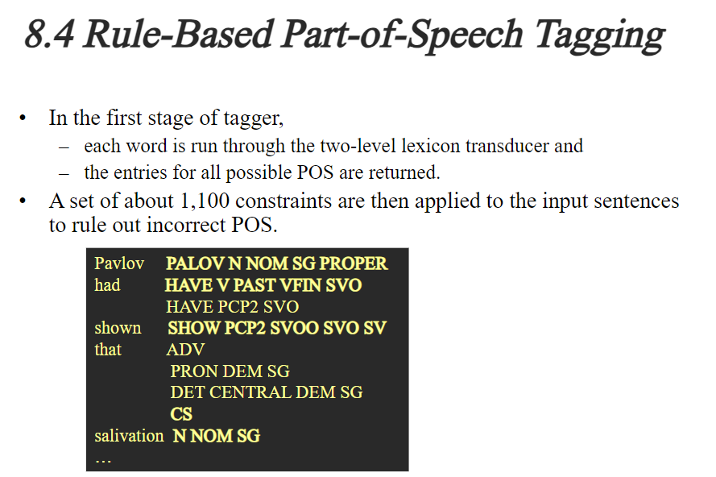

Slide 40
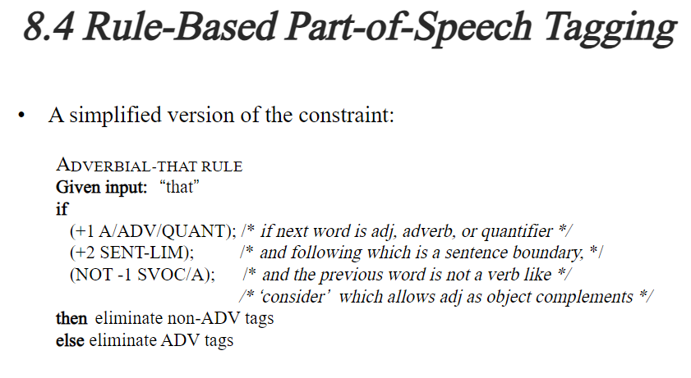

Slide 41
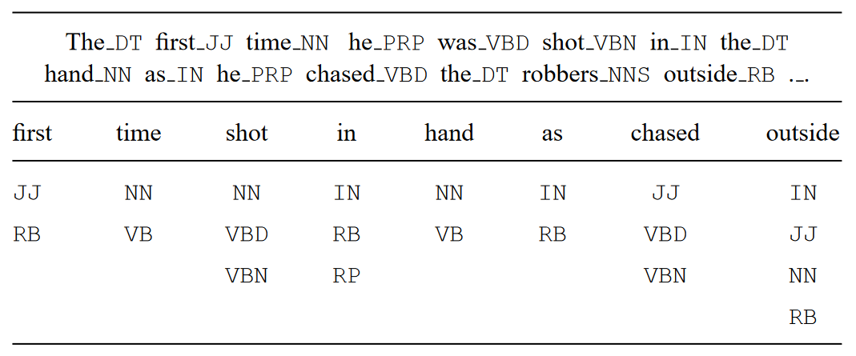
Issues in PoS tagging

Slide 42
In the processing of natural languages, each word in a sentence is tagged with its part of speech. These tags then become useful for higher-level applications. Common parts of speech in English are noun, verb, adjective, adverb, etc.
The main problem with POS tagging is ambiguity. In English, many common words have multiple meanings and therefore multiple POS. The job of a POS tagger is to resolve this ambiguity accurately based on the context of use. For example, the word "shot" can be a noun or a verb. When used as a verb, it could be in past tense or past participle.
POS taggers started with a linguistic approach but later migrated towards a statistical approach. State-of-the-art models achieve accuracy better than 97%. POS tagging research done with English text corpus has been adapted to many other languages.

